Slide 1



Spatio-Temporal Feature Based Air Quality Prediction
Jindong Han,Qianqian Zhang,Juan Liu
（Beijing University of Posts and Telecommunications, China）
and
Binli Luo,Haoran Jiang
(Central South university, China)
Notes:
1

Slide 2
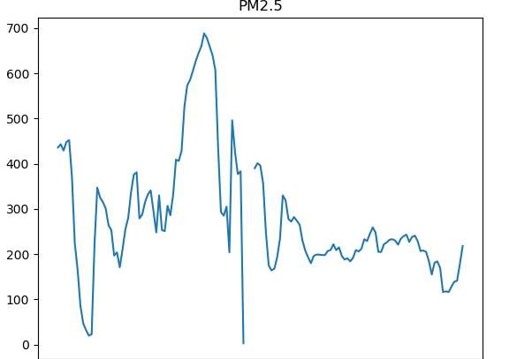
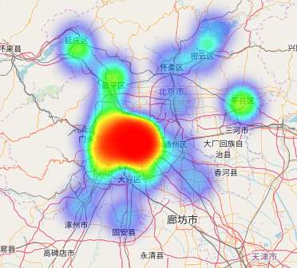
Challenges
The air quality changes rapidly in a short time
Complex spatial dependency
Strong domain knowledge is required

Slide 3
Highlights
Feature engineering: 3 categories, more than 200 features
Temporal features
Wind speed,temperature,humidity,pressure
Frequency domain
Spatial features
Dimension reduction to avoid overfitting
Domain knowledge based features
The uv component of wind etc.

Slide 4
Temporal features
Frequency features
Periodic information and change intensity
Meteorology features( for short-term prediction)
Weather forecast feature (for long-term prediction & sudden changes)
Forecast hour feature (0-47): distinguish first 24 and last 24 hours.
The past 72 hours
The next 48 hours
The next 48 hours
The next 48 hours
Time node predicted
Sliding window

Slide 5
Spatial features
1. Direction-independent feature
Air quality
Temperature,humidity,pressure
Points of grid weather data
Air quality station

Slide 6
Spatial features
2. Direction-based feature
Air quality
The past frequency of wind direction
Wind direction
Wind speed
Points of grid weather data
Air quality station

Slide 7
Spatial features
3. Weather forecast spatial feature
Use k-nearest method
k-nearest neighbor
points of grid weather data
Points of grid weather data
Air quality station

Slide 8
Domain features
The uv component of wind
The difference of humidity between current and previous moment
Sunshine duration,discrete wind speed
Interactive features
Statistical features of other pollutants
v
o
u

Slide 9
Modeling
GBRT prediction for each pollutant
Features
Results
Beijing PM2.5
GBRT
log-exp
Beijing PM2.5
Beijing PM10
GBRT
log-exp
Beijing PM10
Beijing O3
GBRT
Beijing O3
London PM2.5
GBRT
London PM2.5
London PM10
GBRT
London PM10
Beijing's some pollutants have Long-tailed distribution with lots of abnormal values.

Slide 10
Summary
Features! Features! Features!

Slide 11
Thank You !
Notes:
11

